Slide 1
Docker Complete course
Why we need Docker
What is Docker and container
Docker components
Real time scenario usage
Vikas
Notes:
You will learn about Docker and k8s ..two amazing and trending technology in the IT world .
We learn to develop , manage and deploy complex applications using these two .
How are these two connected .
Learn with demos and real-time examples .
We start @ 0 (assuming no prior knowledge) and gain full working experience .

Slide 2


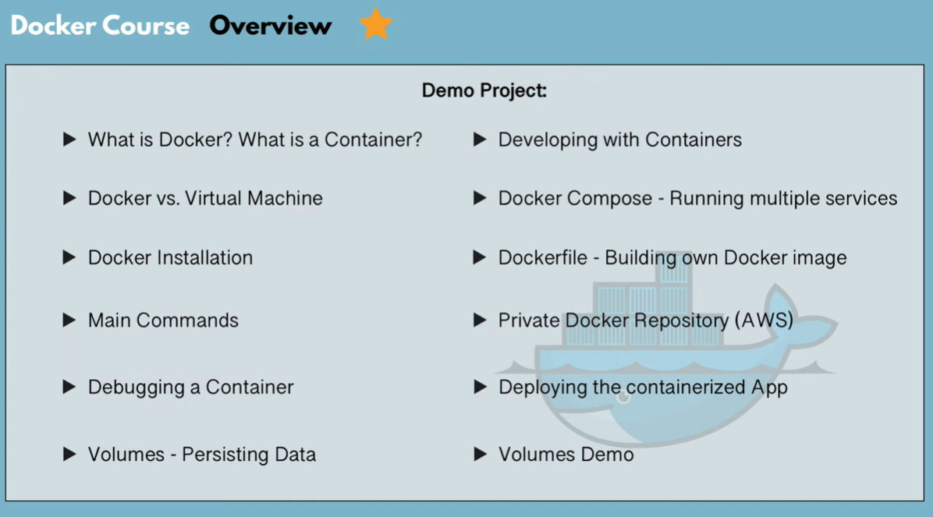




Slide 3
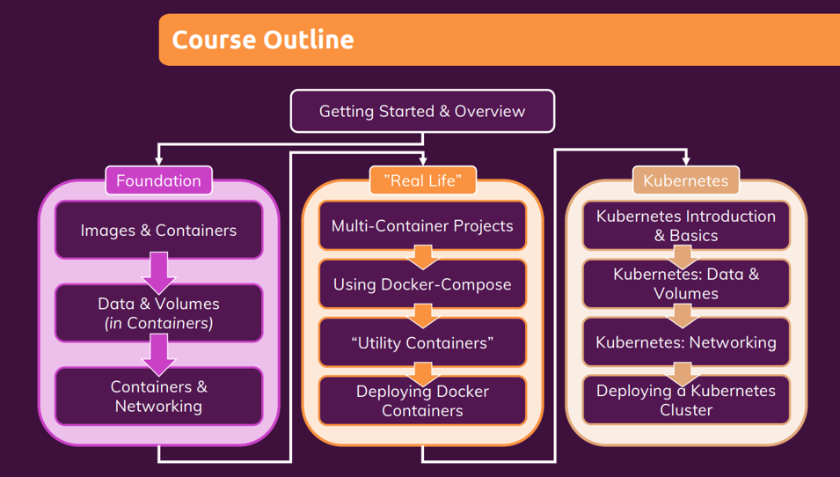
Notes:
Your success matters is the prime motto .
. Understand while you are learning.
. Practice daily
. Don’t get overwhelmed with the new concepts .

Slide 4
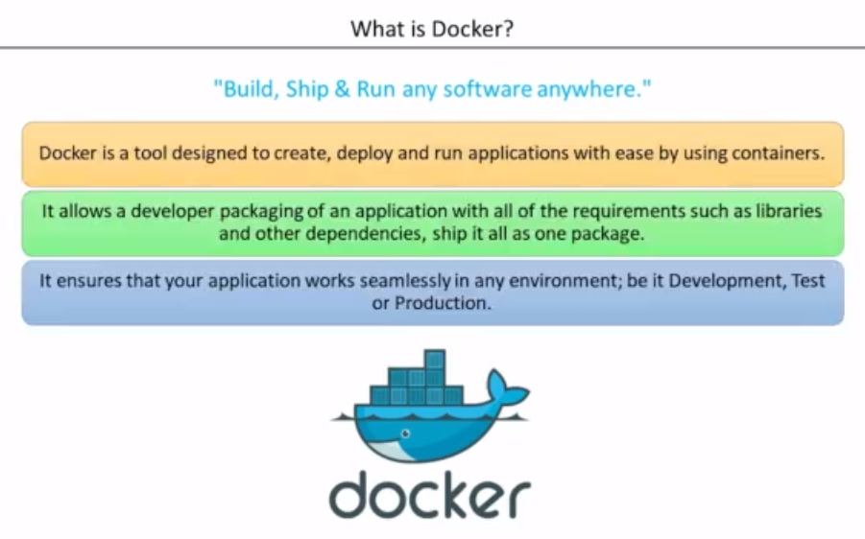
Notes:
Why do we need docker ?
Smoothens the s/w installation process .
Docker is a platform for developing ,shipping and running application using an open-source container-based technology launched in 2013 as an open-source Docker Engine in isolated environment .
A tool for creating and managing containers (OS Level virtualization).
Run everywhere – physical ,virtual or cloud
Run anything – if it can on host , it can run on container .
App runs same is all environment
Benefits :
Docker is designated to make it easier to create , deploy and run applications by using containers .
Light weight alternative to VM and it uses host OS .
You don’t have to pre allocate any RAM in containers .
netstat -tupln

Slide 5
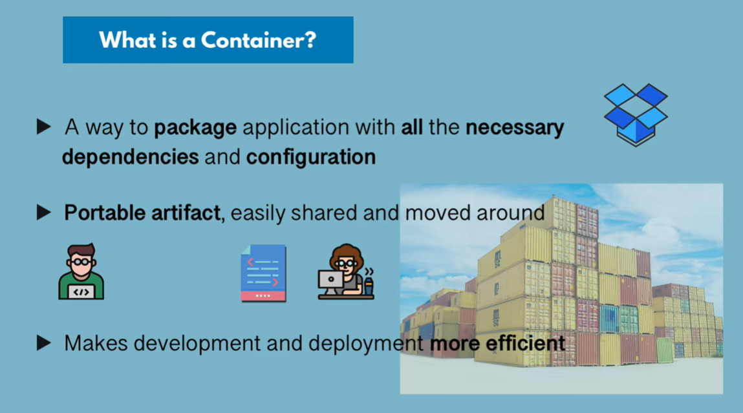
Notes:
Container is a lightweight alternative to full machine virtualization which involves encapsulating an application in a container with its working environment .
Containers – a standardized unit of software .code + run time environment and dependencies .No last-minute surprises .
Work in stand alone mode .Provides abstraction at the app layer that package code and dependencies together .Multiple containers can run on the same machine and share the os kernel with other containers, each running as isolated process in user space .
https://docs.docker.com/get-docker/

Slide 6
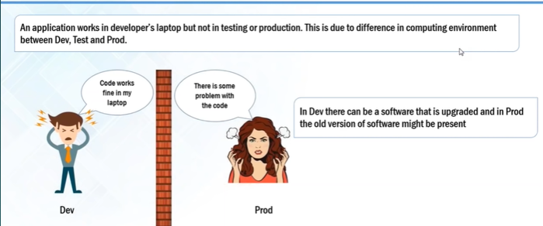
Notes:
User concerns :
Developer /Tester
.Portable runtime environment
. Missing Dependencies and package
. Run tests faster
2. Sys-Admin
.Cost & Performance
. Efficient ,consistent & repeatable
. Speed , reliable of CICD .

Slide 7
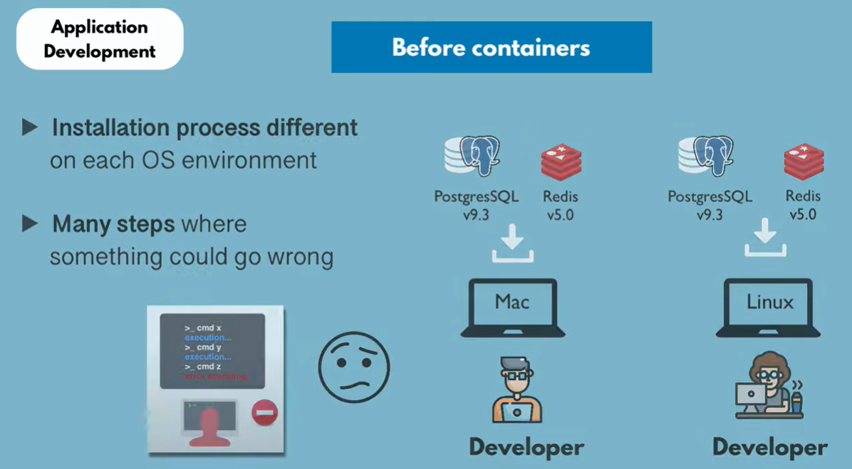
Notes:
Problems :
Compatibility /dependency – due to different dev and prod environment .
Long time to set up
Different dev/test/prod environment

Slide 8
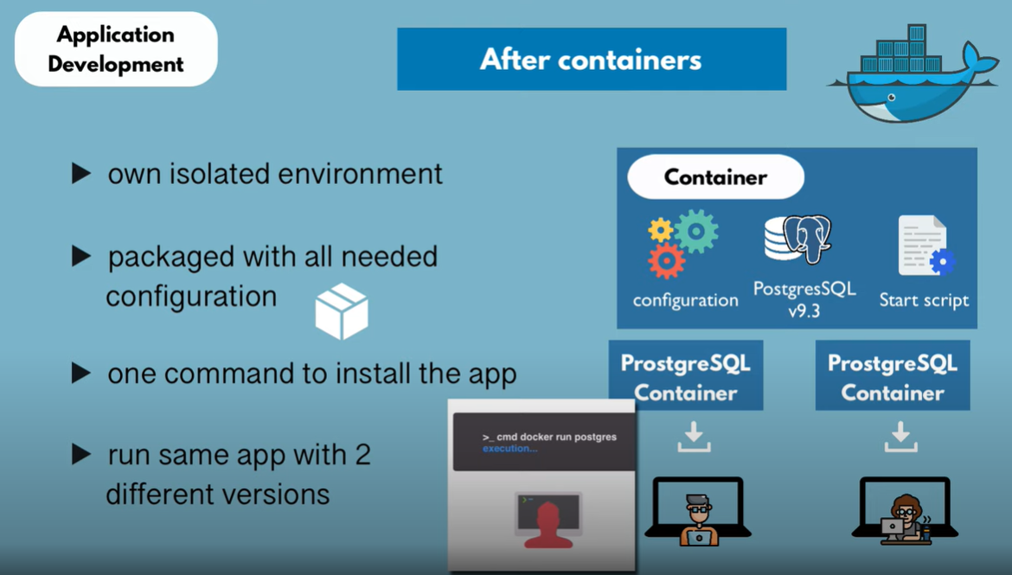

Slide 9
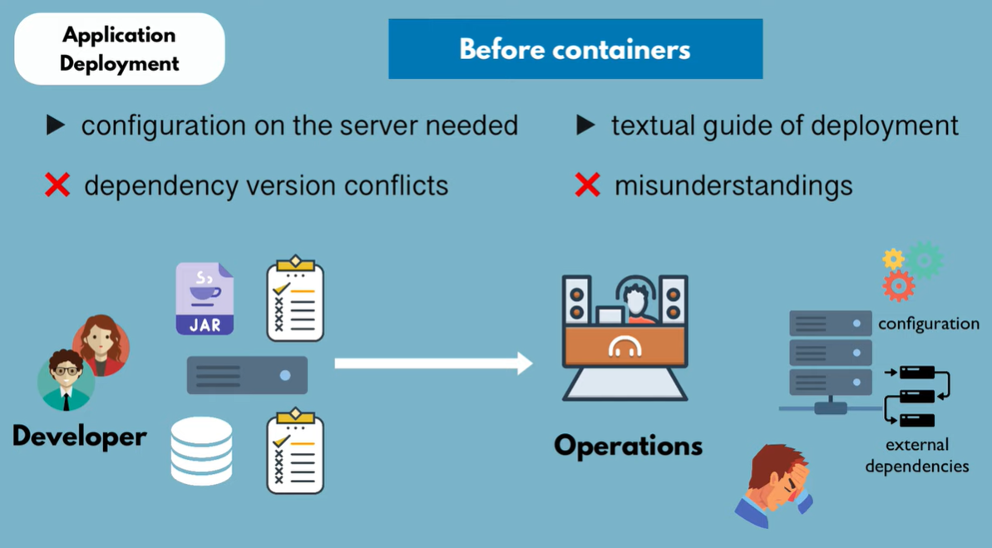
Notes:
How can Docker help ?

Slide 10
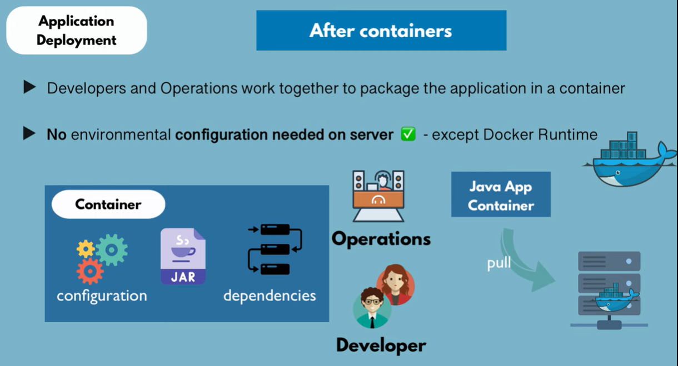

Slide 11
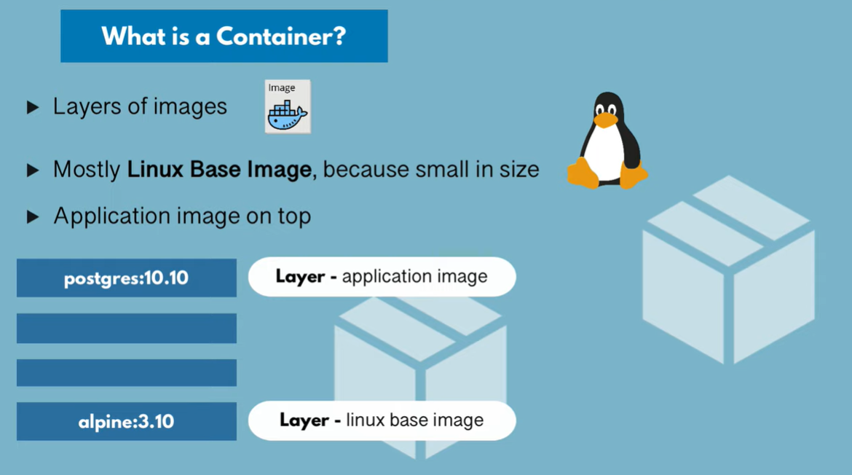

Slide 12
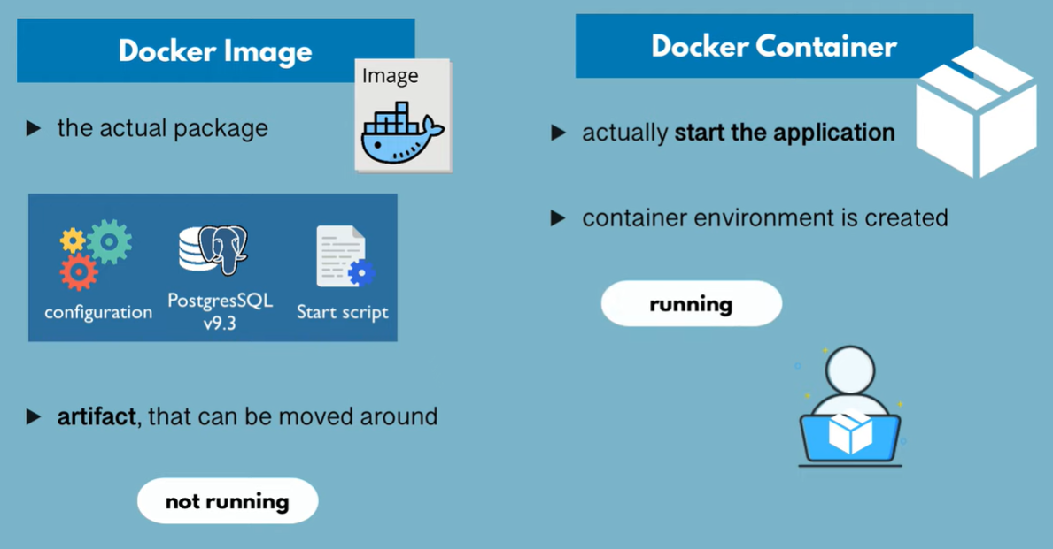
Notes:
Container image is a light weight, stand-alone, executable package of a piece of software that includes everything needed to run it : code ,runtime , system tools ,system libraries, settings.
Available for both Linux and windows-based app, containerized software will run the same , regardless of the environment .
Template/Blueprint to create a environment of your choice .Contains everything which your app needs in read only mode .
The Runtime instance of this image is usually called container.

Slide 13
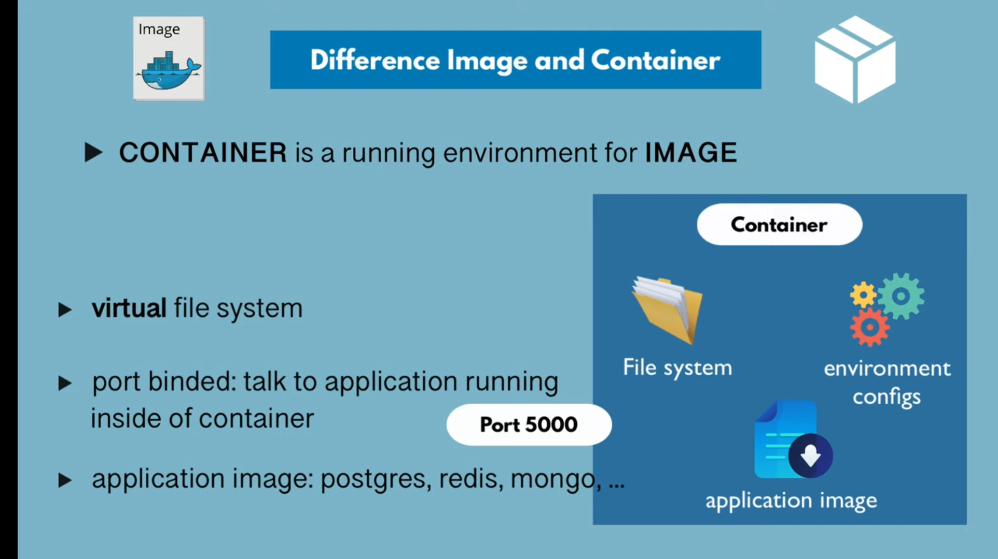
Notes:
Images – blue print (templates ) which contain the code and application .
Container – Running unit of application/software .

Slide 14
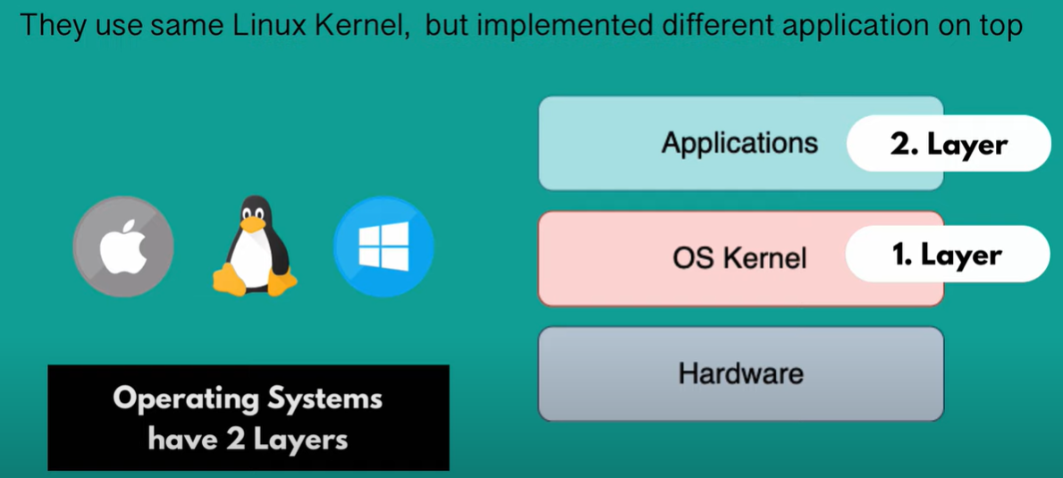
Notes:
docker run busybox:1.24 echo “hello world”
docker run busybox:1.24 ls /
docker run –it busybox:1.24
docker run –name any_name busybox:1.24
docker inspect <container_id>
docker run -d -p 8080:80 -v $(pwd):/usr/share/nginx/html nginx – create a index.html @this location
docker run -d -p 8081:80 –volume-from<container whose volume has be shared> nginx -- > share volume
https://startbootstrap.com/themes/landing-pages
Docker File :
========
FROM nginx:latest
ADD . /usr/share/nginx/html
New Images are built in two ways :
1.
docker run –it debian:jessie
ls
apt-get update && apt-get install –y git
docker commit <commit id > vikas24775/debian:1.0 -- > new image
2. docker file
nano Dockerfile
FROM debian:jessie
apt-get update
apt-get install –y git
apt-get install –y vim
docker build –t vikas24775/debian:1.0
Shorter and refined version :
FROM debian:jessie
RUN apt-get update && apt-get install –y \
git \
python \
vim
CMD [“echo“, “helo world”]
now docker build –t vikas24775/Debian . And then docker run <container id > == o/p hello world
use –no-cache=true if you don’t want to cache
Copy command in container :
remove CMD and use COPY abc.txt /src/abc.txt
Docker tag command :
use docker images to list all the images
docker tag <image id > vikas24775/????:1.01
docker login --username=vikas24775
docker push vikas24775/????:1.01
git clone –b v0.1 https://github.com/vikas99341/dockerapp.git
cd dockerapp/
ls to see two file
docker build -t dockerapp:v0.1 . == > build starts
docker run –d –p 5000:5000 <image id>
docker exec –it <container id> bash – to go inside the running container
cd /home/admin
ps axu
git clone -b v0.1 https://github.com/jleetutorial/dockerapp.git

Slide 15
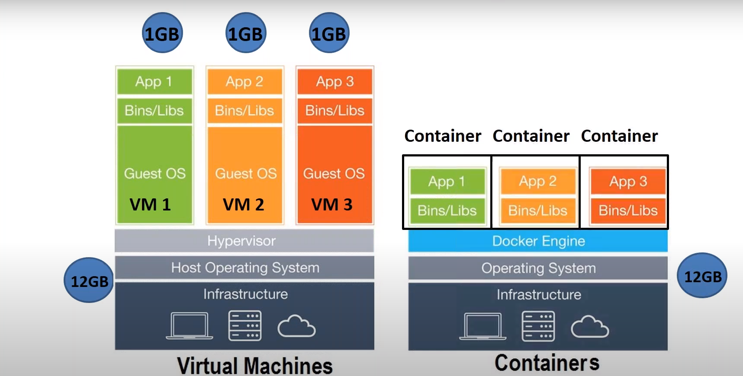
DOCKER CONTAINERS VS VIRTUALIZATION
Notes:
Docker is a lightweight ,stand-alone, executable package of a piece of software that includes everything needed to run it : code ,run time, system tools, system libraries ,settings . These are ideal to run all major linux , windows ,VM or any cloud .Containers isolate application from one another and from the underlying infrastructure ,Hence secure to use .

Slide 16
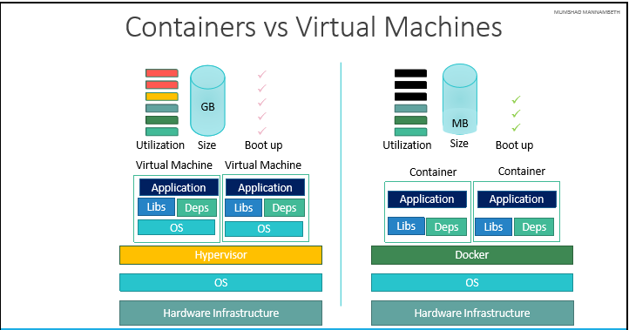
Notes:
Docker container is next step to VM .
Docker is a lightweight ,stand-alone, executable package of a piece of software that includes everything needed to run it : code ,run time, system tools, system libraries ,settings . These are ideal to run all major linux , windows ,VM or any cloud .Containers isolate application from one another and from the underlying infrastructure ,Hence secure to use .

Slide 17
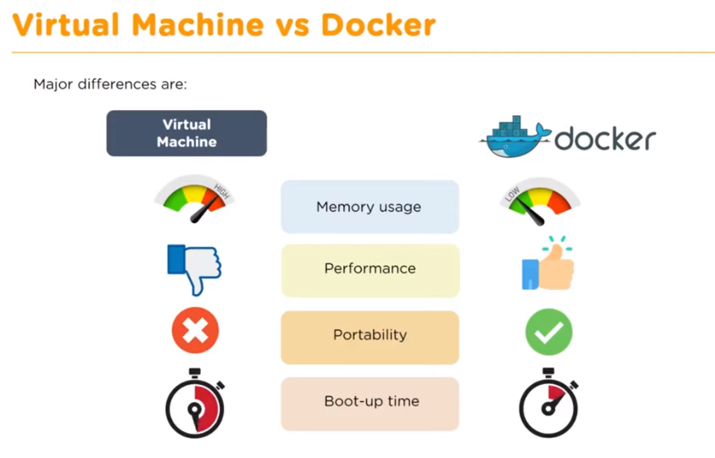
Notes:
Benefits :
Reuse extra memory
Easy deployment

Slide 18
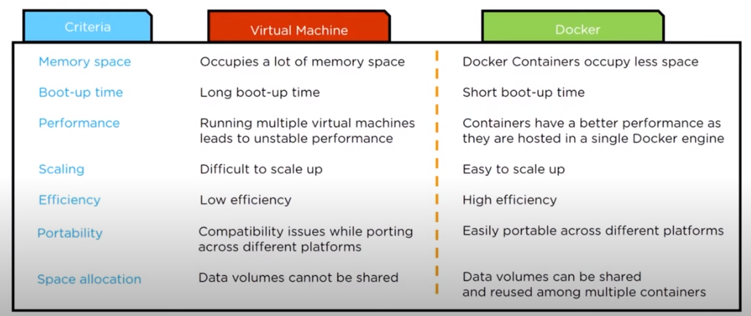
Notes:
Docker Volume : Data preservation methodology
================================
docker volume ls
docker volume create volume vol1
docker volume inspect <volume name> -- > by default storage is /var/lib/docker
docker run -it --name <any name> -v <volume on container>:<directory on host> <container id> == > docker run –it --name container1 –v vol1:/data ubuntu
this volume can be attached to multiple containers.
docker volume rm vol1
Bind Mount : Another way to share container data with host machine with location choice
===========================================================
cd tmp/logs -- > create a file.txt -- >
docker run –it –name <container name> -v /tmp/logs:/data:Z <image name>
/tmp/logs in host machine is mapped to /data on container .
Create a dockerfile :
=============
FROM ubuntu
Maintainer “Vikas”
RUN apt-get update
RUN apt-get install vim –y
CMD /bin/echo “Hello from Docker”
docker build –t <image name required> .
docker images to check the image created
Docker Network:
============
docker network ls -- > see the default networks
1. bridge 2. host 3. null
docker network inspect bridge -- > check the containers section
Different containers under same network can talk with each other via ip address
apt-get update && apt-get install –y iputils-ping
take one of the the container ip from inspect command and use it on the other one to see connectivity .
Create a custom bridge :
===============
docker network create --driver bridge <bridge name>
docker run -itd --name <container name> --network <network created > <image from hub>
Port Publishing or forwarding on Docker:
===========================
docker run -itd --name <container name> nginx
docker inspect <container name> -- > to get the IPAddress
curl ip:80 -- > get the o/p
docker run -itd --name <container name> -P nginx
docker run -itd --name <container name> -p 9999:80 nginx

Slide 19
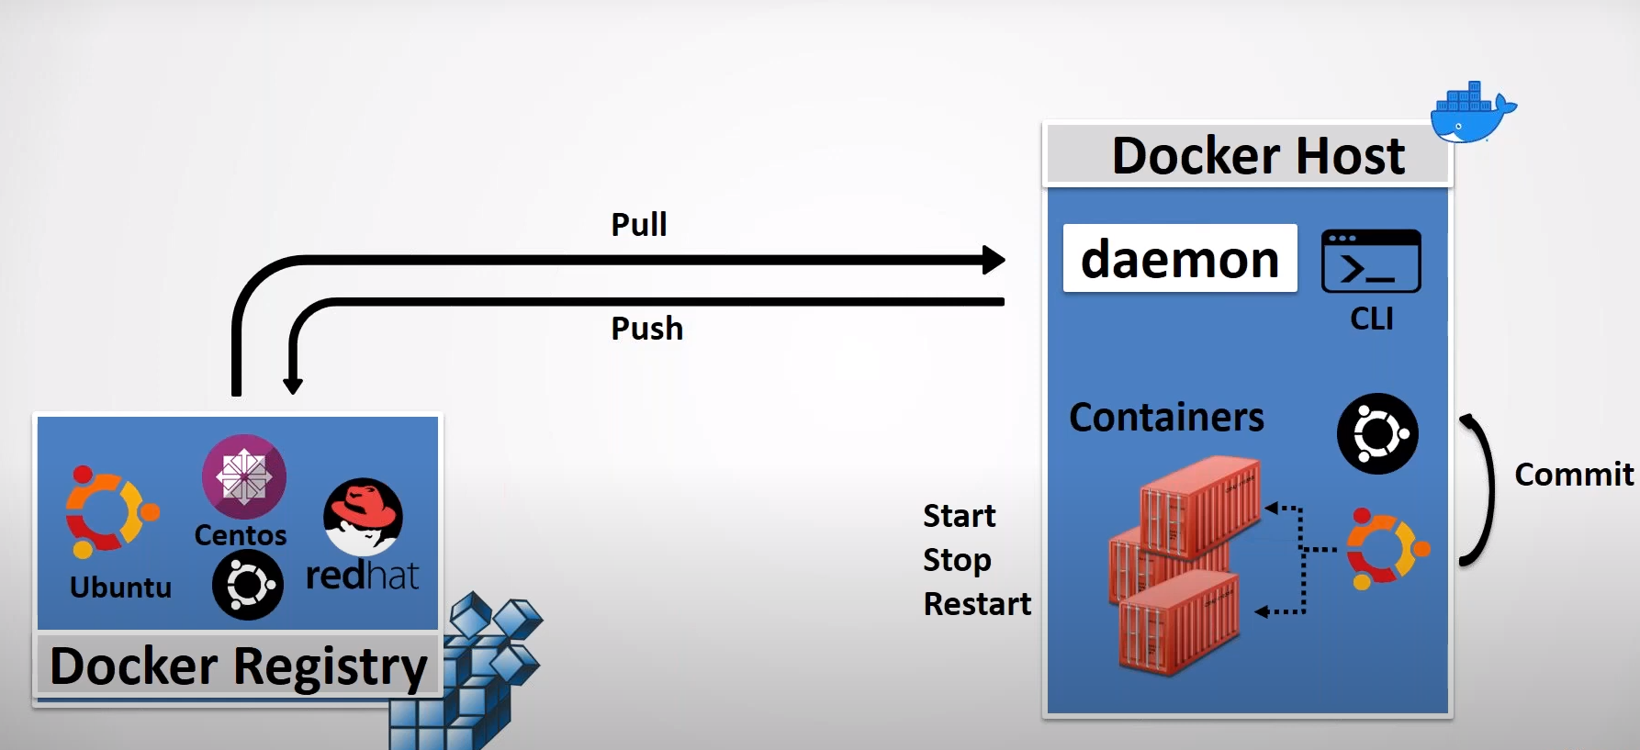
DOCKER SYSTEM :
Notes:
Docker File :
-------------
FROM node:14
WORKDIR /app
COPY package.json .
RUN npm install
COPY . .
EXPOSE 3000
CMD [ "node", "app.mjs" ]
Docker build .
Docker run –p 3000:3000 <container id >

Slide 20
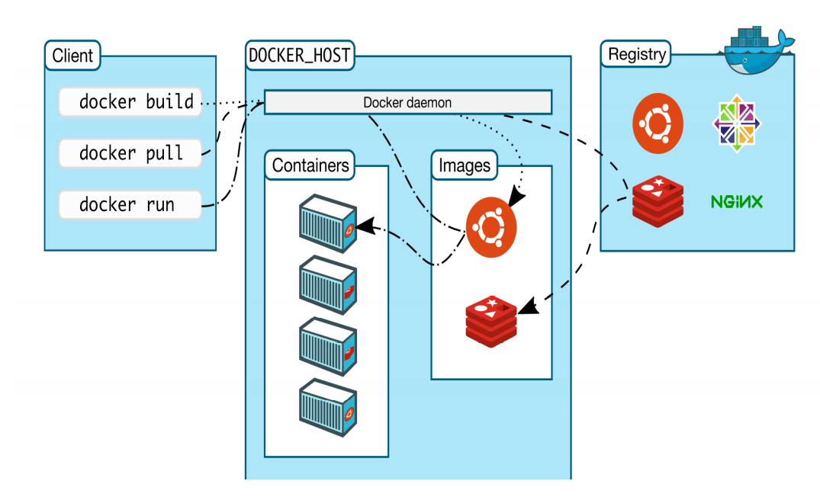
Notes:
Docker Architecture :
Docker Client – provides a UI to run API Calls
Docker Daemon - run Docker commands
Docker Registry –

Slide 21
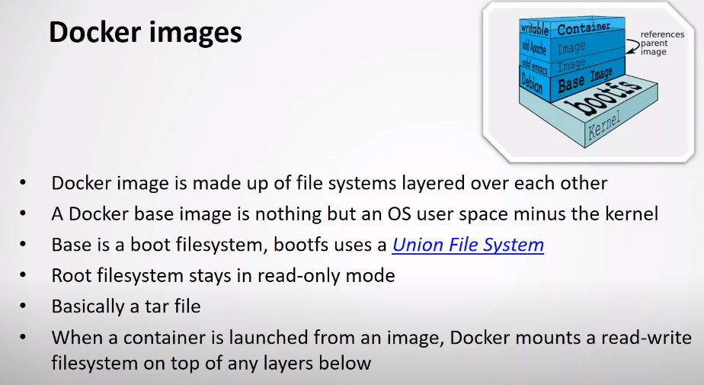
Notes:
. Ready to use templates for creating containers.
. Build by Docker users .
. Stored in Docker hub or local Registry.

Slide 22
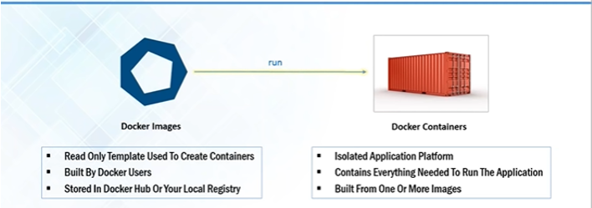
Notes:
Image is a static file by running which you get a container .
Image : The basis of docker container .The content at rest .
Container : Image when it’s running .The standard unit for app service .
Engine : The software that executes command for containers .Can be clustered together .Networking and volumes are part of this engine .

Slide 23
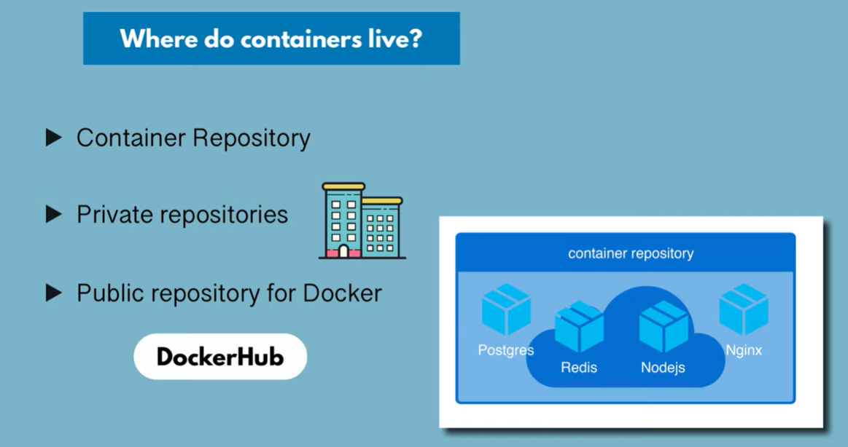
Notes:
Containers are standard packaging of software and its dependencies which is isolated from each other and work independently on any OS .
Registry : stores ,distributes and manages docker images .
Control Plane : Management plane for container and cluster orchestration .

Slide 24
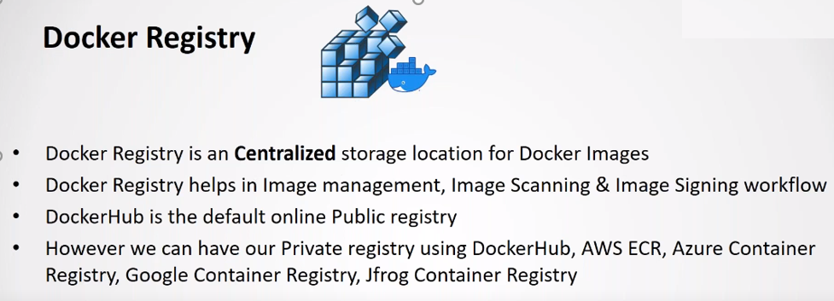
Notes:
. Storage component for Docker Images in public/private repository .
docker info
which docker
df –kh . == > see available space

Slide 25
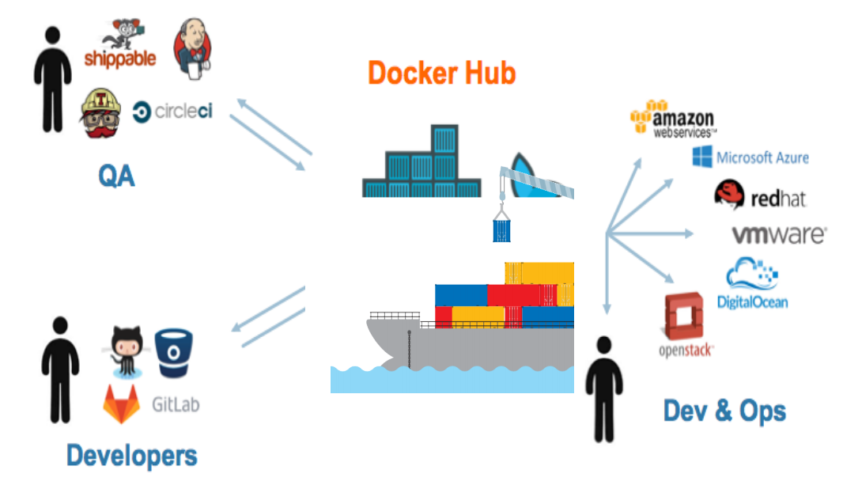

Slide 26
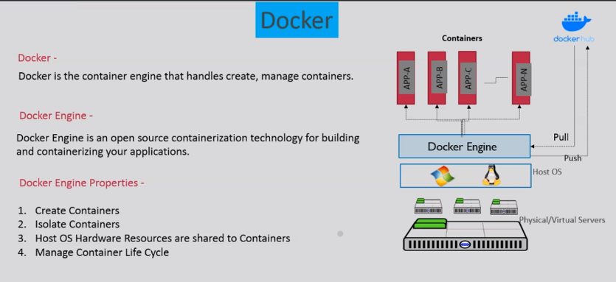
Notes:
Commands:
------------
yum install docker –y
systemctl start docker
docker version
docker run hello-world
docker ps –a
docker ps
docker images
docker run –it <container id> -- > exit to come out or ctrl +p +ctrl +q
docker run –itd <container id> -- > run in detached manner
docker attach <container id> -- if you want to go inside the container
docker start <container id>
docker stop <container-id>
docker rm <container-id> -- cannot remove a running container or use –f option .
docker rmi <image-id>

Slide 27
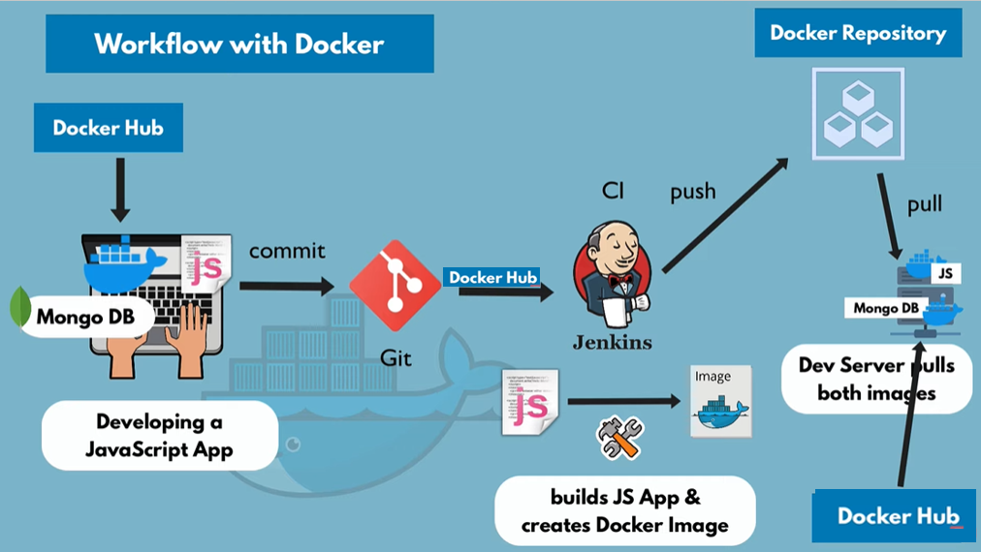
Notes:
https://stackoverflow.com/questions/8205369/installing-npm-on-aws-ec2
rm -rf /etc/yum.repos.d/nodesource-el*
curl -sL https://rpm.nodesource.com/setup_10.x | sudo -E bash –
yum install nodejs --enablerepo=nodesource

Slide 28
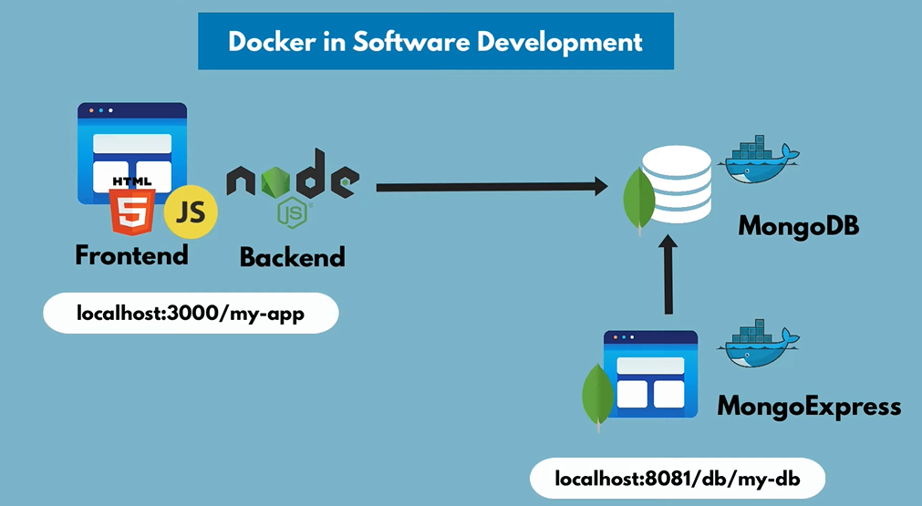
Notes:
Docker in Practice (JS and Nodejs Application with MongoDB and Mongo Express UI)
=======================================================
docker pull mongo
docker pull mongo-express
docker network create mongo-network
docker run -d -p 27017:27017 -e MONGO_INITDB_ROOT_USERNAME=admin -e MONGO_INITDB_ROOT_PASSWORD=password --net mongo-network --name mongodb mongo
docker logs <container id received> -- > check for waiting for connection on 27017
6. docker run -d -p 8081:8081 -e ME_CONFIG_MONGODB_ADMINUSERNAME=admin -e ME_CONFIG_MONGODB_ADMINPASSWORD=password -e ME_CONFIG_MONGODB_SERVER=mongodb --net mongo-network --name mongo-express mongo-express
7. docker logs <container id>
8. Connect to the mongo server on <cloud_ip>:8081
9.

Slide 29
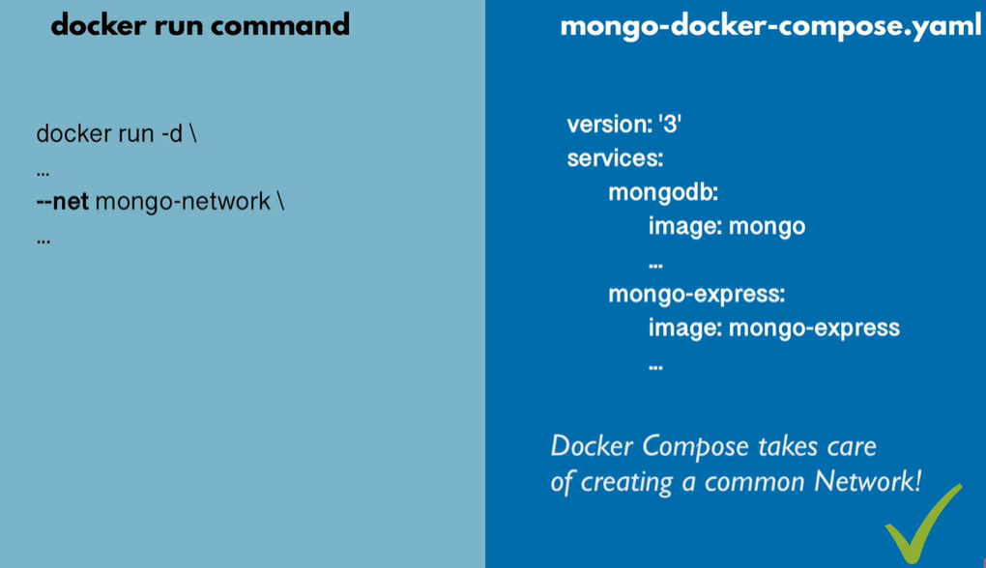
Notes:
https://docs.docker.com/compose/install/
C:\Users\kuvikas\Desktop\Docker-prac\nana\techworld-js-docker-demo-app-master
docker-compose –f docker-compose.yml up
check the new common network on docker
ADD – Command will copy any file from docker host (cli) to docker container .

Slide 30
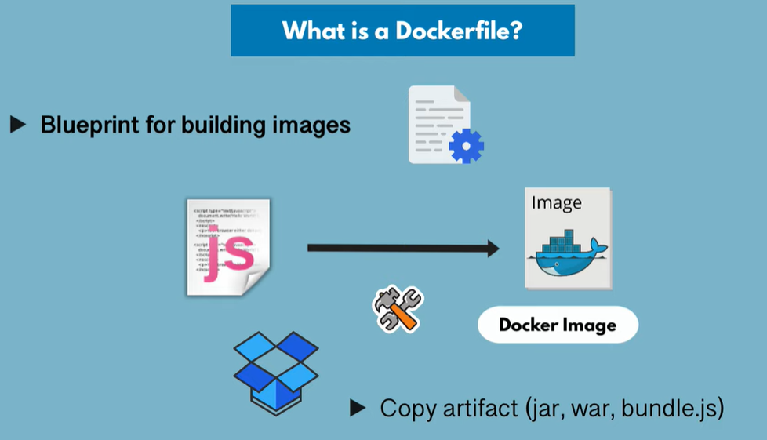

Slide 31
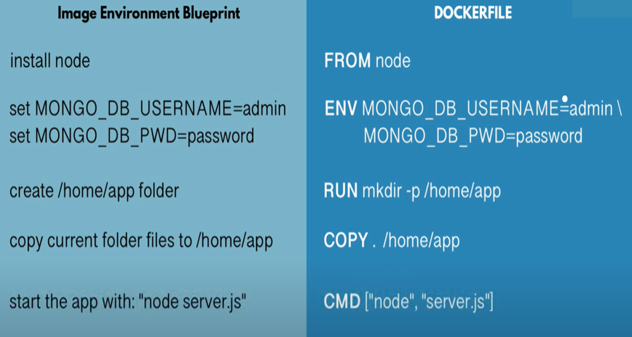
Notes:
A Docker file is a blueprint for building an image
Keywords:
FROM: Talks about the base image
ENV: Optional as environment variables are defined here.
RUN - Execute any Linux command. Execution will happen inside the container.
COPY – The source can be local, and the destination is inside the container
CMD – Always part of docker file. Execute entry point Linux command.
Multiple RUN commands can be there but only one CMD command.
docker ps -a | grep my-app

Slide 32
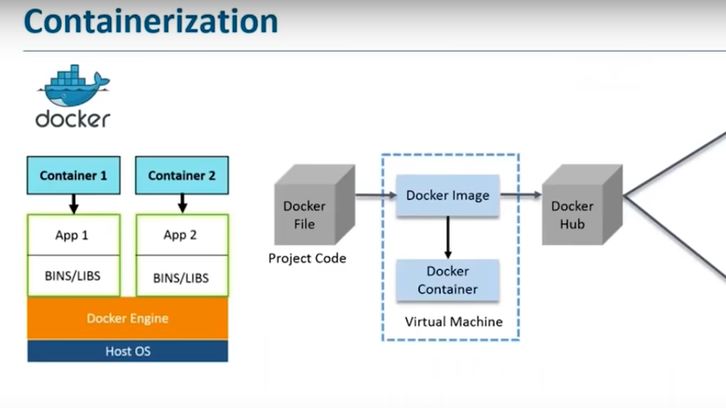
Notes:
Install docker on amazon linux :
-------------------------------
yum install docker –y
Common commands:
-------------------------
docker pull ubuntu
docker images / docker image ls
docker run –it –d ubuntu -- > attached to a container it should be in running mode .
docker ps –a /docker ps
docker run -d --name test-tomcat-server -p 8090:8080 tomcat:latest
docker exec –it <container_id> bash
docker kill <container_id>
docker rm <container id> -- > will remove the container but it should be stopped
docker rm -f <container_id> -- > delete container forcefully
docker rmi <image id> -- > to remove the image
docker rm –f $(docker ps –a –q )
docker commit
docker start <container id >
docker stop <contain ner id >
come out of atatched mode -- > ctrl +p .ctrl +q
root@df33de3dcefb:/usr/local/tomcat/webapps.dist# cp -R * ../webapps
docker exec -it tomcat-vikas /bin/bash
Create a volume to preserve the data present in container :
----------------------------------------------------------
docker volume ls -- > list
docker volume create vol1 -- > create a volume
docker volume inspect vol1 -- > see the location
docker run -it --name <any name> -v vol1:/data <container name>
docker volume rm vol1
Bind Mount :
-----------
docker run -it --name <any name> -v <bind mount location eg: /tmp/logs>:/data:Z Ubuntu -- > this Z flag will enable read write in container .
docker run -it --name <any name> --volumes-from <existing container name > Ubuntu
Docker Installation on Ubuntu machine :
--------------------------------------------
sudo apt-get update
sudo apt-get install docker.io
dockerfile :
------------
From ubuntu
Maintainer “Vikas”
RUN apt-get update
RUN apt-get install vim –y
CMD /bin/echo “ I am from ubuntu container “
To run this, say == > docker build –t myimage .

Slide 33
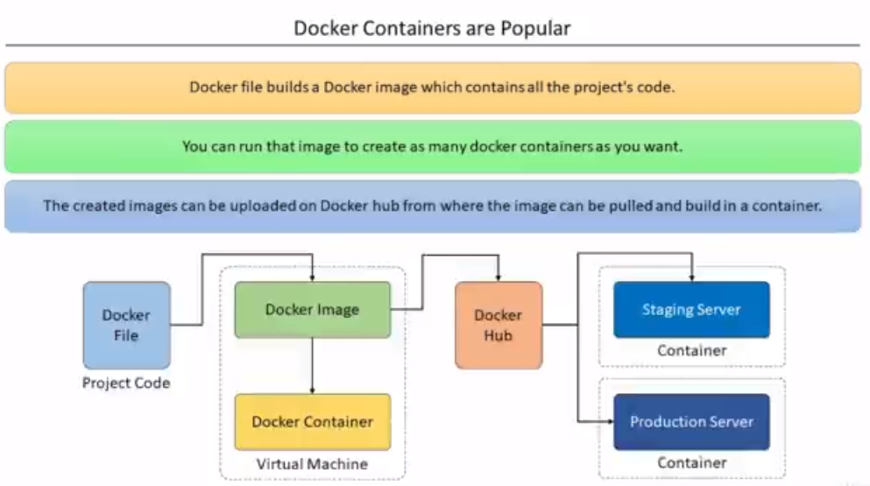
Notes:
Docker File : is a text document that contains all the commands a user could call on the command line to assemble an image .Using Docker build users can create an automated build that executes several commands-line instruction in sucession.
docker inspect <image-name>
From container:
-----------------
docker export <container id > > update.tar
docker import - newimage < update.tar
From Image:
-------------
docker save -o update1.tar newimage
docker rmi newimage
docker load < update1.tar

Slide 34
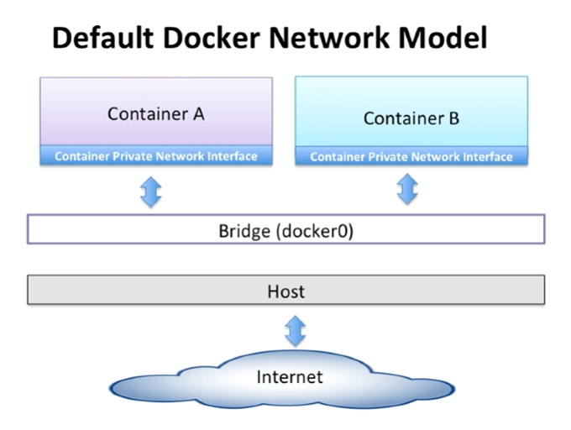

Slide 35
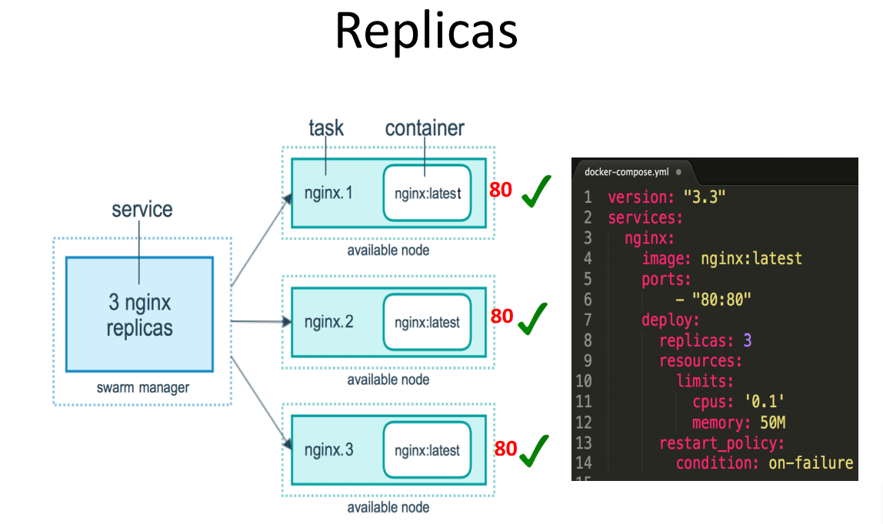

Slide 36
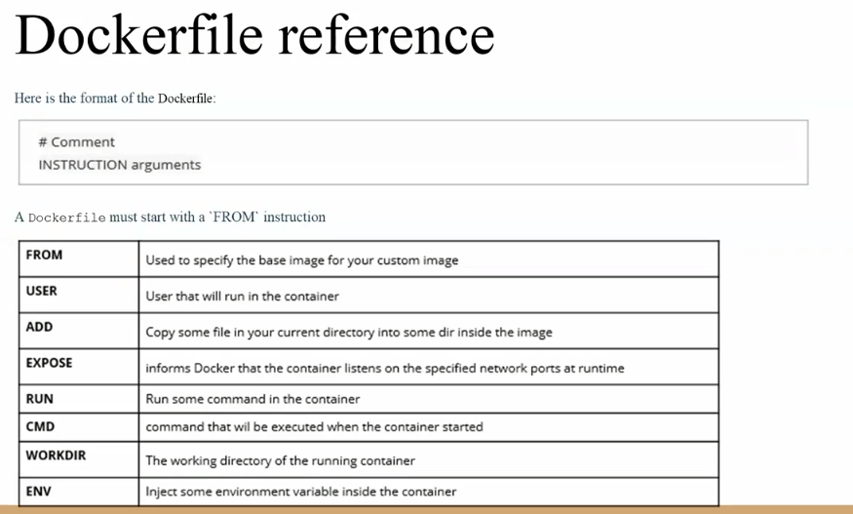
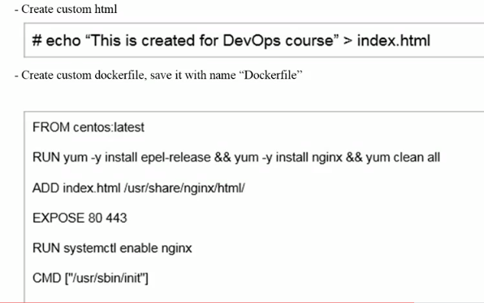
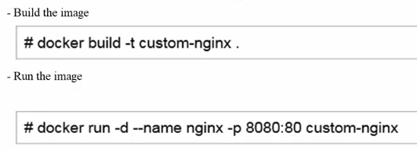
Notes:
# echo “This is created for devops Course” > index.html
Dockerfile :
FROM centos:latest
RUN yum install
==========================================
Steps to create a Docker file : in Docker machine home@dockeradmin
---------------------------------
vi Dockerfile
# Pull tomcat latest image from dockerhub
From tomcat:latest
# Maintainer
MAINTAINER “Vikas"
# copy war file on to container
COPY ./webapp.war /usr/local/tomcat/webapps
docker build –t devops-project .
docker images
docker run -- name devops-container –p 8080:8080 devops-project

Slide 37
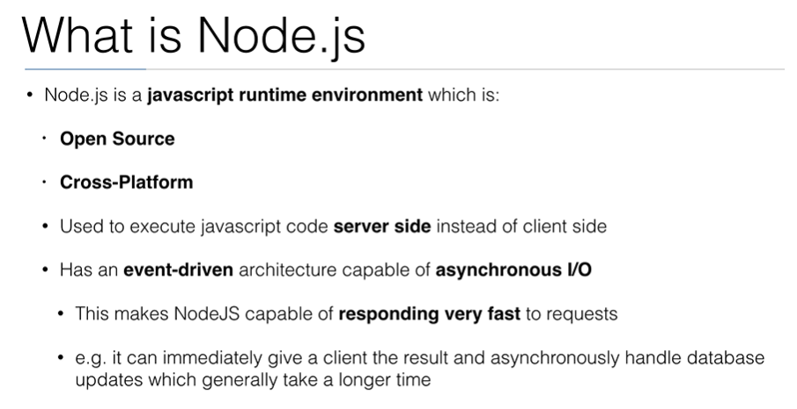
Notes:
Used by paypal, uber ,yahoo ,Netflix, Mozilla etc.
Easy to understand .
Dosen’t have to be compiled so will take less memory when compared to Java .
Steps :
npm install
npm test
Sample Nodejs app : https://github.com/vikas99341/docker-demo
index.js has the express package to handle http request and log the details .
package.json for metadata and dependencies
Docker file : has the running details
Run via Jenkins :
Look for nodejs plugin
Global tool configuration : Install automatically NpdeJS version 7.10.0 and just name it .
You see Build environment Provide nodejs build path
Commpand npm install
Cloudbees docker build and publish plugin
new freestyle project
https://github.com/vikas99341/docker-demo
Install nodejs plugin from jenkins plugin

Slide 38
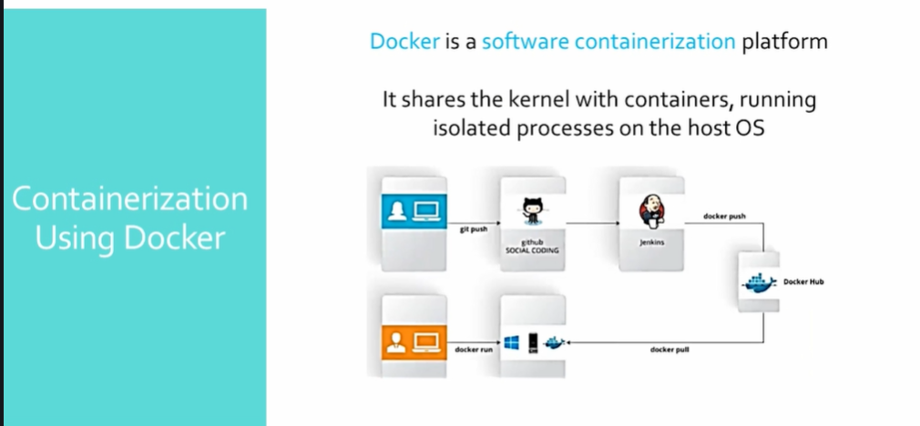
Notes:
Scalable –lightweight- Starts instantly and uses less compute and RAM .
Portable – Docker Apps can run anywhere
Build any app in any language using any stack
You don’t have to pre-allocate any RAM
Docker applications and resources are isolated and segregated.
Environment standardization and version control – Ideal to run on all Linux .MS windows and any other VM or bare metal as well as cloud .
Secure – These isolated application run independently from the underlying infrastructure.

Slide 39
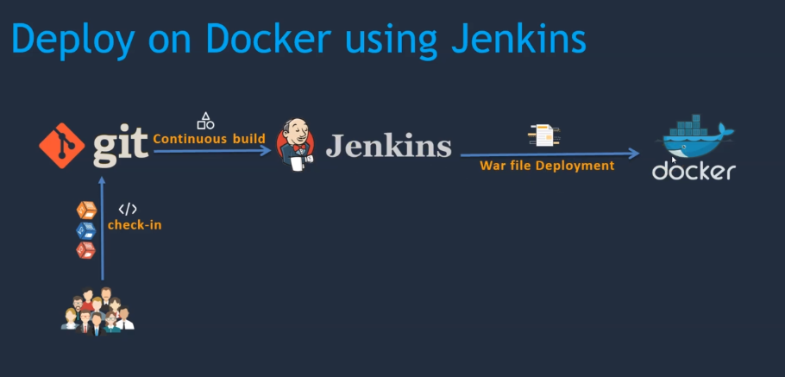
Notes:
docker run -d --name tomcat-container -p 8081:8080 tomcat:latest
Install Publish Over SSH plugin for Jenkins .
Create a user dockeradmin and assign him a password .
useradd -aG docker dockeradmin
cat /etc/group
id dockeradmin -- > to check if he is added .
from root directory : vi /etc/ssh/sshd_config -- > change password authentication to yes -- > service sshd reload .
Manage Jenkins -- > configure system -- > Publish over SSH -- > Name = <any name> -- > host name = <pvt ip of your machine > -- >username =docker admin
advanced -- > password based authentication -- > give password -- > test connection -- > must get success message
create a new job in Jenkins -- > in post build -- > send build artifact over SSH -- >
source file = var/lib/jenkins./workspace/<job-name>/webapp/target == but path is webapp/target/*.war
remote directory = . (home/dockeradmin by default )
Exec Command : cd /home/dockeradmin ; docker build –t devops-image . ; docker run -d --name devops-container -p 8080:8080 devops-image ;
Make sure :
no webapp.war is not already there
no images are there
no containers are running

Slide 40
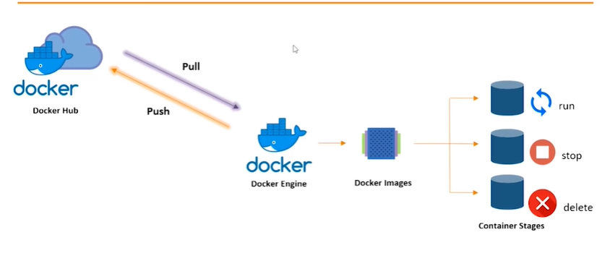

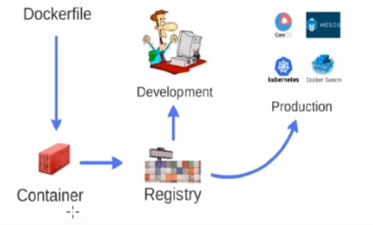
Notes:
Docker file builds a Docker image and that image contains all the project’s code
you can run that image to create as many containers as you want
then this images can be uploaded on Docker hub, from Docker hub any one can pull the image and build a container .
Run this from dockeradmin Home directory :
sudo dockeradmin
vi Dockerfile
FROM tomcat:latest
MAINTAINER Vikas
COPY ./webapp.war /usr/local/tomcat/webapps
Docker ps - > no container must be running .
Docker build -t devops-project .
Check for image -- > docker images
docker run --name devops-container –p 8080:8080 devops-project

Slide 41
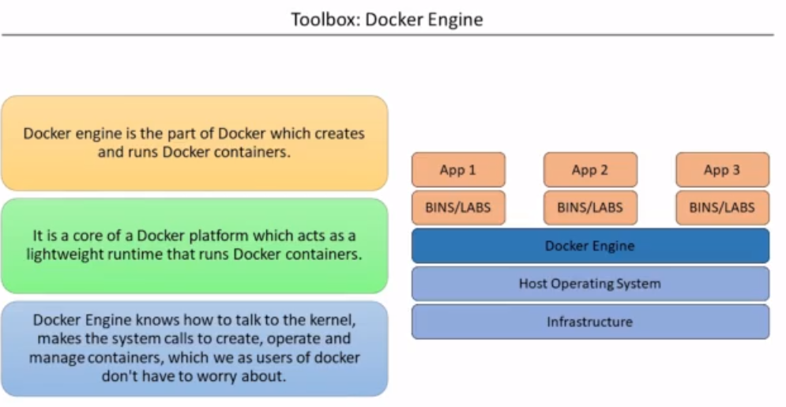

Slide 42
Create create-simple-devops-image.yml
Remove any containers running
ansible-playbook -i hosts create-simple-devops-image.yml
Check in the hub for the new file
Create a new simple-devops-project.yml
ansible-playbook -i hosts simple-devops-project.yml
Go ahead and change hosts file add pvt ip of docker machine .
Modify Jenkins job in EXEC Commands say “ansible-playbook -i /opt/docker/create-simple-devops-image.yml –limit localhost ;
ansible-playbook -i /opt/docker/create-simple-devops-project.yml –limit <docker hostip> ;
Notes:
create-simple-devops-image.yml : to be written at /opt/docker as ansadmin user
----------------------------------------
---
- hosts: all
become: true
tasks:
- name: building docker image
command: docker build -t simple-devops-image:latest .
args:
chdir: /opt/docker
- name: creating tag for image
command: docker tag simple-devops-image vikas24775/simple-devops-image
- name: push image to docker hub
command: docker push vikas24775/simple-devops-image
- name: remove image from ansible server
command: docker rmi simple-devops-image:latest vikas24775/simple-devops-image
ignore_errors: yes
simple-devops-project.yml
=====================
---
- hosts: all
become: true
tasks:
- name: stop if we have old docker container
command: docker stop simple-devops-container
ignore_errors: yes
- name: remove stopped docker container
command: docker rm simple-devops-container
ignore_errors: yes
- name: remove current docker image
command: docker rmi vikas24775/simple-devops-image
ignore_errors: yes
- name: building docker image
command: docker build -t vikas24775/simple-devops-image .
args:
chdir: /opt/docker
- name: creating docker image
command: docker run -d --name simple-devops-container -p 8080:8080 vikas24775/simple-devops-image

Slide 43
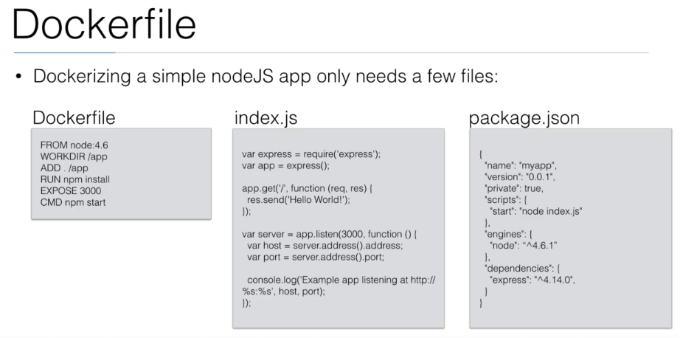

Slide 44
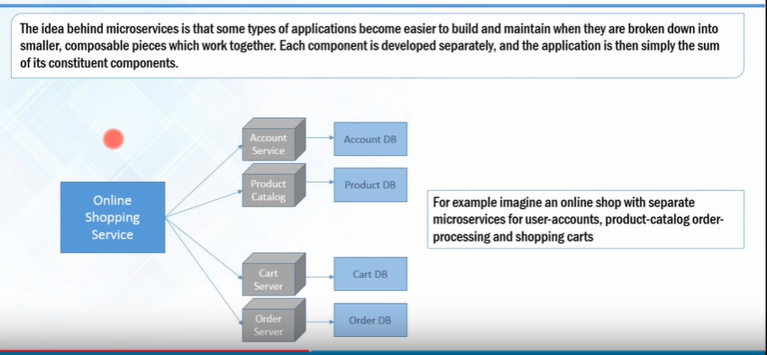

Slide 45
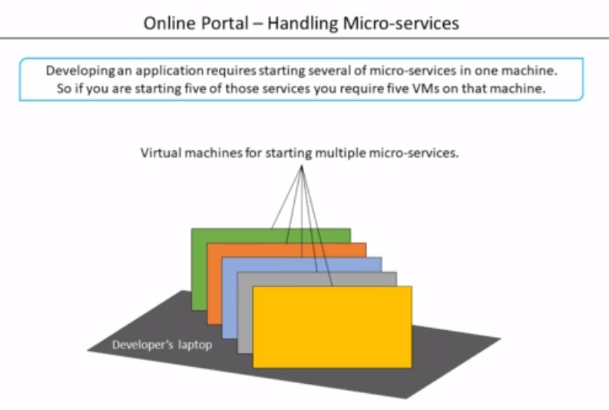
Notes:
Benefits :
Exact same environment in prod and dev .
Share common development environment .
No need to install and uninstall local dependencies and runtime environment all time .
docker –rm will remove the container when you stop them .
docker image inspect <image-id>
docker run –p 80808:80 –d –rm –name
docker tag <old-name> <new-name>

Slide 46
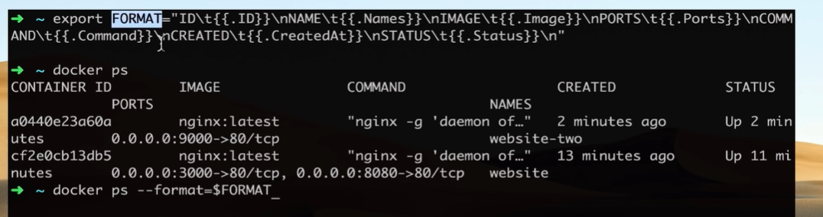
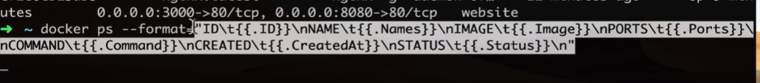
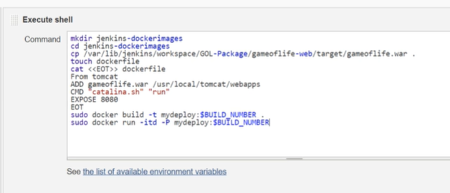
Notes:
systemctl start docker
vim /etc/sudoers
jenkins ALL=(ALL) NOPASSWD: ALL

Slide 47
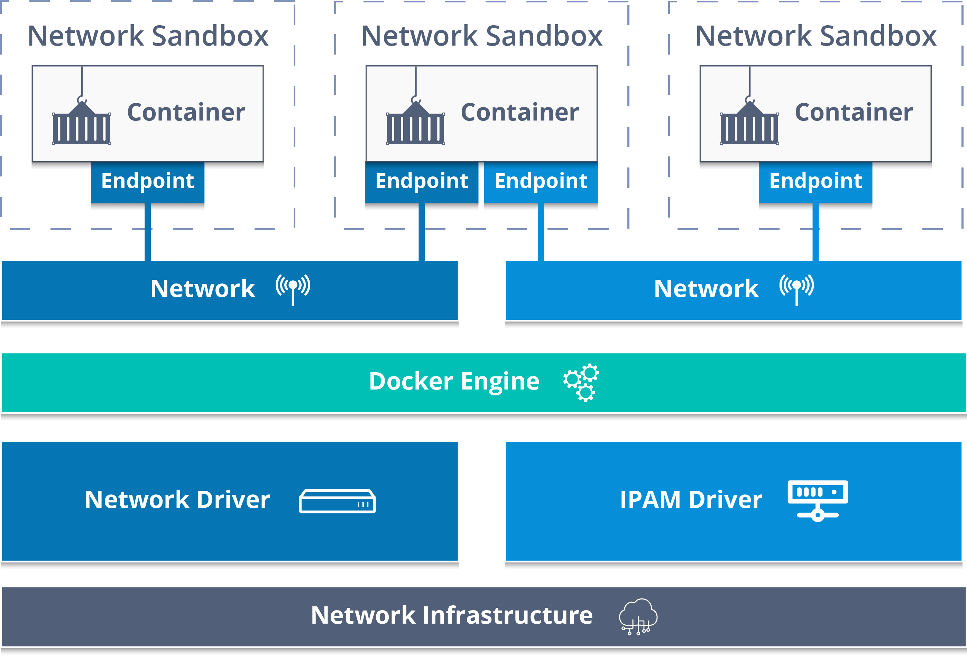
Notes:
Docker Network :
https://www.docker.com/blog/understanding-docker-networking-drivers-use-cases/
https://docs.docker.com/network/
docker network ls
docker network --help
docker network ls -f driver=bridge
docker network ls --format "{{.ID}}: {{.Driver}}"
docker network inspect "networkid"
docker network create "networkname"
docker network create -d bridge "networkname“
docker network rm “networkname”
docker network connect "networkname" "containername"
docker container run -d --name "nameofcontainer" --network "networkname" image
docker network disconnect "networkname" "containername“
Docker exec –it nginx1 bash
apt-get update
apt-get install iputils-ping
docker exec -it “nginx2" ping “nginx3"

Slide 48



Notes:
https://docs.docker.com/compose/wordpress/
nano docker-compose.yaml
docker-compose up –d
RUN commands always executes in a new layer and creates a new image layer. Eg: RUN apt-get install mysql , it is often used for installing software packages and applications.
CMD commands allows to sets default command and/or parameter. This will be executed if you run a particular container without specifying some command, which can be overwritten from command line when docker container runs.
ENTRYPOINT looks similar to CMD , however it configures a container that will run as an executable form. If you want to run a container with the condition that a particular command is always executed, use ENTRYPOINT.
https://github.com/vikas99341/Docker-Compose-nodeJs-MongoDB-Nginx--.git
Dockerfile:
=======
FROM alpine
CMD echo “Hello World ”
docker build –t <name> . == > docker run –it <name> == > docker run –it <name> sh
Dockerfile:
=======
FROM alpine
ENTRYPOINT [“/bin/echo”, “Hello”]
CMD [“World ”]
docker build –t <name> . == > docker run –it <name> vikas

Slide 49

Notes:
we will see the procedure for dockerizing a Node.js web app and have NGINX as a reverse proxy in front of NodeJS app using docker
A reverse proxy is a server that sits in front of a group of web servers and when a users makes an HTTP request through a browser, the request first goes to the reverse proxy server, and which then sends the request to the appropriate web server. Using reverse proxy, the main benefit is Security: With a reverse proxy, the web server never reveals its IP address to the client which is trying to access the webserver in our case it is node js, which makes the server more secure.
Easy Load Balancing: with reverse proxy in from of the website , it is easy to handle the traffic send to the webserver, we can distribute the load to the website across may servers.
https://github.com/vikas99341/nodejs-nginx-reverse-proxy-in-docker
https://github.com/vikas99341/nodedocker_app

Slide 50


Slide 52

Docker file
Notes:
A Dockerfile is a text document that contains all the commands a user could call on the command line to assemble an image and build images automatically by reading the instructions from a Dockerfile. A Docker image consists of read-only layers each of which represents a Dockerfile instruction.
FROM: The FROM instruction initializes a new build stage and sets the Base Image for subsequent instructions. Base Image can be any valid image.
LABEL : LABEL added to image to organize images by project, record licensing information. Eg: LABEL com.example.version=“0.0.1-beta“
RUN : RUN instruction will execute any commands in a new layer on top of the current image and commit the results.
CMD : CMD instruction should be used to run the software contained by your image, along with any arguments. There can only be one CMD instruction in a Dockerfile. If you list more than one CMD then only the last CMD will take effect. The main purpose of a CMD is to provide defaults for an executing container.
EXPOSE : EXPOSE instruction indicates the ports on which a container listens for connections.
ENV : ENV instruction sets the environment variable
ADD : ADD instruction copies new files, directories or remote file URLs from and adds them to the filesystem of the image at the path .
VOLUME : VOLUME instruction should be used to expose any database storage area, configuration storage, or files/ folders created by your docker container.
WORKDIR : WORKDIR instruction sets the working directory for any RUN, CMD, ADD instructions that follow it in the Dockerfile.
Extend Docker Official Nginx Image.
https://kubernetes.io/docs/tutorials/kubernetes-basics/create-cluster/cluster-interactive/

Slide 53

Data Persistence
Notes:
Volumes : Volumes are stored in a part of the host filesystem which is managed by Docker.
eg: docker container run -d - -name mysql –e MYSQL_ALLOW_EMPTY_PASSWORD=True -v mysql-db:/var/lib/mysql mysql
eg: Run My SQL with named Volume
docker container run -d - -name mysql –e MYSQL_ALLOW_EMPTY_PASSWORD=True - -mount source=mysql-db, target=/var/lib/mysql mysql
Bind mounts may be stored anywhere on the host system and non-docker processes on the Docker host or a Docker container can modify them at any time, but it can’t be use in DockerFile.
Eg : docker container run -d - -name nginx - -mount type=bind, source=$ (pwd),target=/app nginx
docker pull -- > docker inspect -- >

Slide 54

Notes:
docker run -u root -d --name jenkins -p 8080:8080 --mount type=volume,source=jenkins_backup,target=/var/jenkins_home jenkins/jenkins:lts-jdk11
/var/lib/docker/volumes/
docker run -u root -d --name jenkins -p 8080:8080 --mount type=bind,source=/tmp,target=/var/jenkins_home jenkins/jenkins:lts-jdk11

